Slide 1
R for Libraries
Part 1: Nuts & Bolts of R
Clarke Iakovakis
Scholarly Services Librarian
Oklahoma State University
This work is licensed under a Creative Commons Attribution 4.0 International License.

Slide 2

About me
Scholarly Services Librarian at Oklahoma State University
BA in History, 2006; MS in Information Studies, 2011; MA in History in progress
My background is in the humanities, not math, not science, not statistics, not computer science, not computer programming.
You do not have to be a statistician or programmer to learn and use R!

Slide 3
Session overview
Session 1: Introduction to R and R Studio
Session 2: Reading and Exploring Data
Session 3: Analyzing and Visualizing Data

Slide 4
Poll Question
What programs do you currently use for your data cleanup, analysis & visualization?
Check all that apply. Type other answers into the Questions box.
Excel
Tableau
Usage analysis tool provided by vendor (e.g. Intota Assessment, EBSCO Usage Consolidation)
SPSS/SAS/other statistics program
OpenRefine

Slide 5

This will be overwhelming!
Refer to the handout and stay positive!

Slide 6

Outline for Session 1: Nuts & Bolts
About R
About R Studio
R Basics:
Writing & evaluating expressions
Assigning variables
Calling functions
Vectors
Data frames
Troubleshooting errors

Slide 7
What is R?
More of a programming language than a statistics program
Originators described it as, "A language for data analysis and graphics"
It can do
Data creation, importing & web scraping
Data cleaning & reshaping
Data visualization
Statistics & modeling
Text mining
Much more

Slide 8
Why R?
Complex Data Manipulation
Easier Automation
Faster Computation
Reads any kind of data
Project organization
Larger datasets
Reproducibility & sharing
Finding and fixing errors
Free & open source
Advanced statistics
State-of-the-art graphics
Runs on many platforms
Active user community
One-stop shop for
Data reading
Cleaning
Processing
Analyzing
Visualizing
Communicating
Adapted from Isaac Petersen, “Why R is Better Than Excel for Fantasy Football (and most other) Data Analysis (R-Bloggers, 2014). https://www.r-bloggers.com/why-r-is-better-than-excel-for-fantasy-football-and-most-other-data-analysis/

Slide 9
Download R
Go to https://www.r-project.org/
Click on CRAN (Comprehensive R Archive Network) under Download
scroll down to your country
select the download link corresponding to the city that is geographically closest to you

Slide 10

Download R
Free and open source
GNU General Public License
Anyone can access the source code, build on it, improve it, and create packages & software to enhance user experience and functionality

Slide 11

Advantages of R
Large user base in a variety of fields
Multiple academic disciplines: Statistics, Education, Genomics, Earth Sciences, Finance, Linguistics, Literature
Data science
Tech industry: Microsoft, Google, Facebook
Major companies: American Express, Ford, Uber
Journalism: The New York Times, The Guardian
Government: National Weather Service, Federal Drug Administration
Getting help
Stack Overflow
R Project email lists
http://www.listendata.com/2016/12/companies-using-r.html
http://blog.revolutionanalytics.com/2012/06/applications-of-r-in-government.html

Slide 12
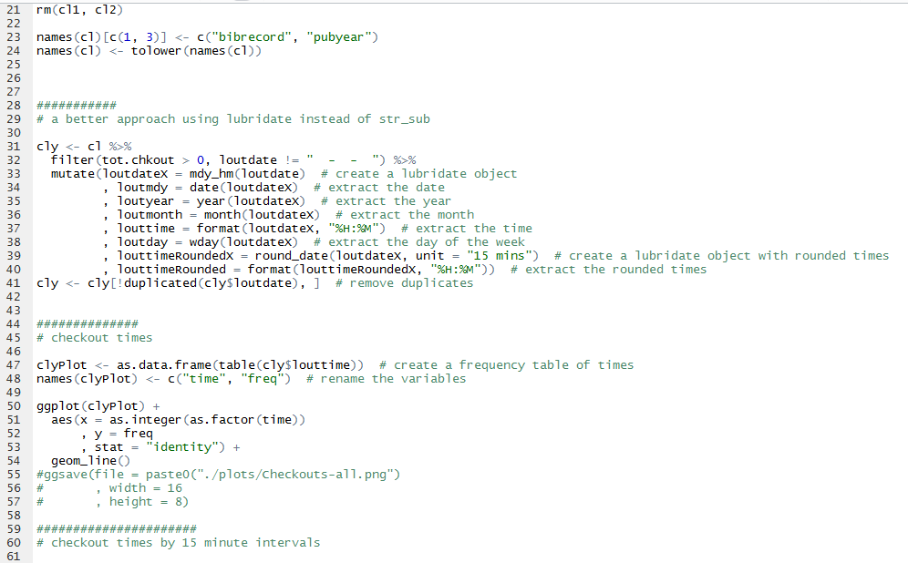
Drawbacks of R
Objects must be stored in physical memory
No Graphical User Interface: the command line can be intimidating!
If this stops you in your tracks, look at the R Commander software at www.rcommander.com, which provides a graphical user interface for R.
Roger Peng. Overview & History of R. https://www.youtube.com/watch?v=STihTnVSZnI

Slide 13
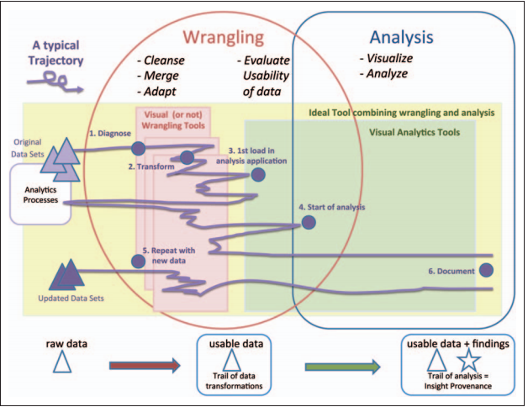
Image © Sean Kandel et al., "Research Directions in Data Wrangling: Visualizations and Transformations for Usable and Credible Data," Information Visualization 10, no. 4 (2011): 273. Open Access version: http://vis.stanford.edu/files/2011-DataWrangling-IVJ.pdf

Slide 14

The new tool scale
Time it takes to learn a new tool
Expected advantages of adopting the tool
Scale image via Wikimedia at https://commons.wikimedia.org/wiki/File:Balanced_scale_of_Justice.svg. Public Domain.

Slide 15

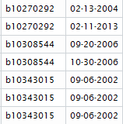
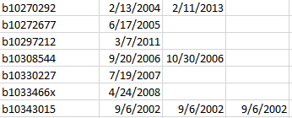
R uses in libraries
Clean and merge messy data from the ILS
Multiple repeated fields
e.g., order dates based on bib records
Clean ISBNs & convert to 10 or 13 digit
Detect data errors & anomalies
"0300017502;9780300017502;0300018509 (pbk.);9780300018509 (pbk.)"

Slide 16
R uses in libraries
Clean and merge messy data from vendors
Normalizing names
Removing/adding hyphens & other punctuation
Creating custom subsets
Merging data
Data fields often included in one dataset and not another

Slide 17
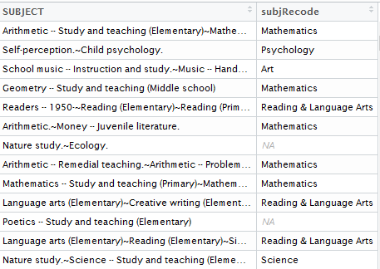
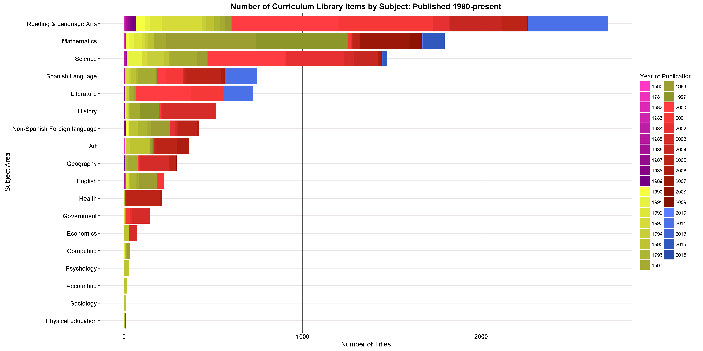
R uses in libraries
Recoding variables

Slide 18
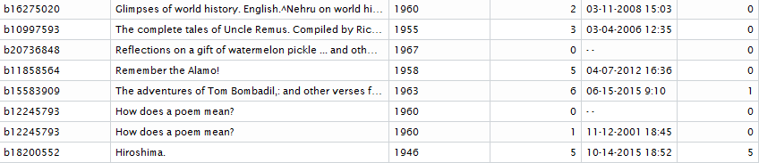
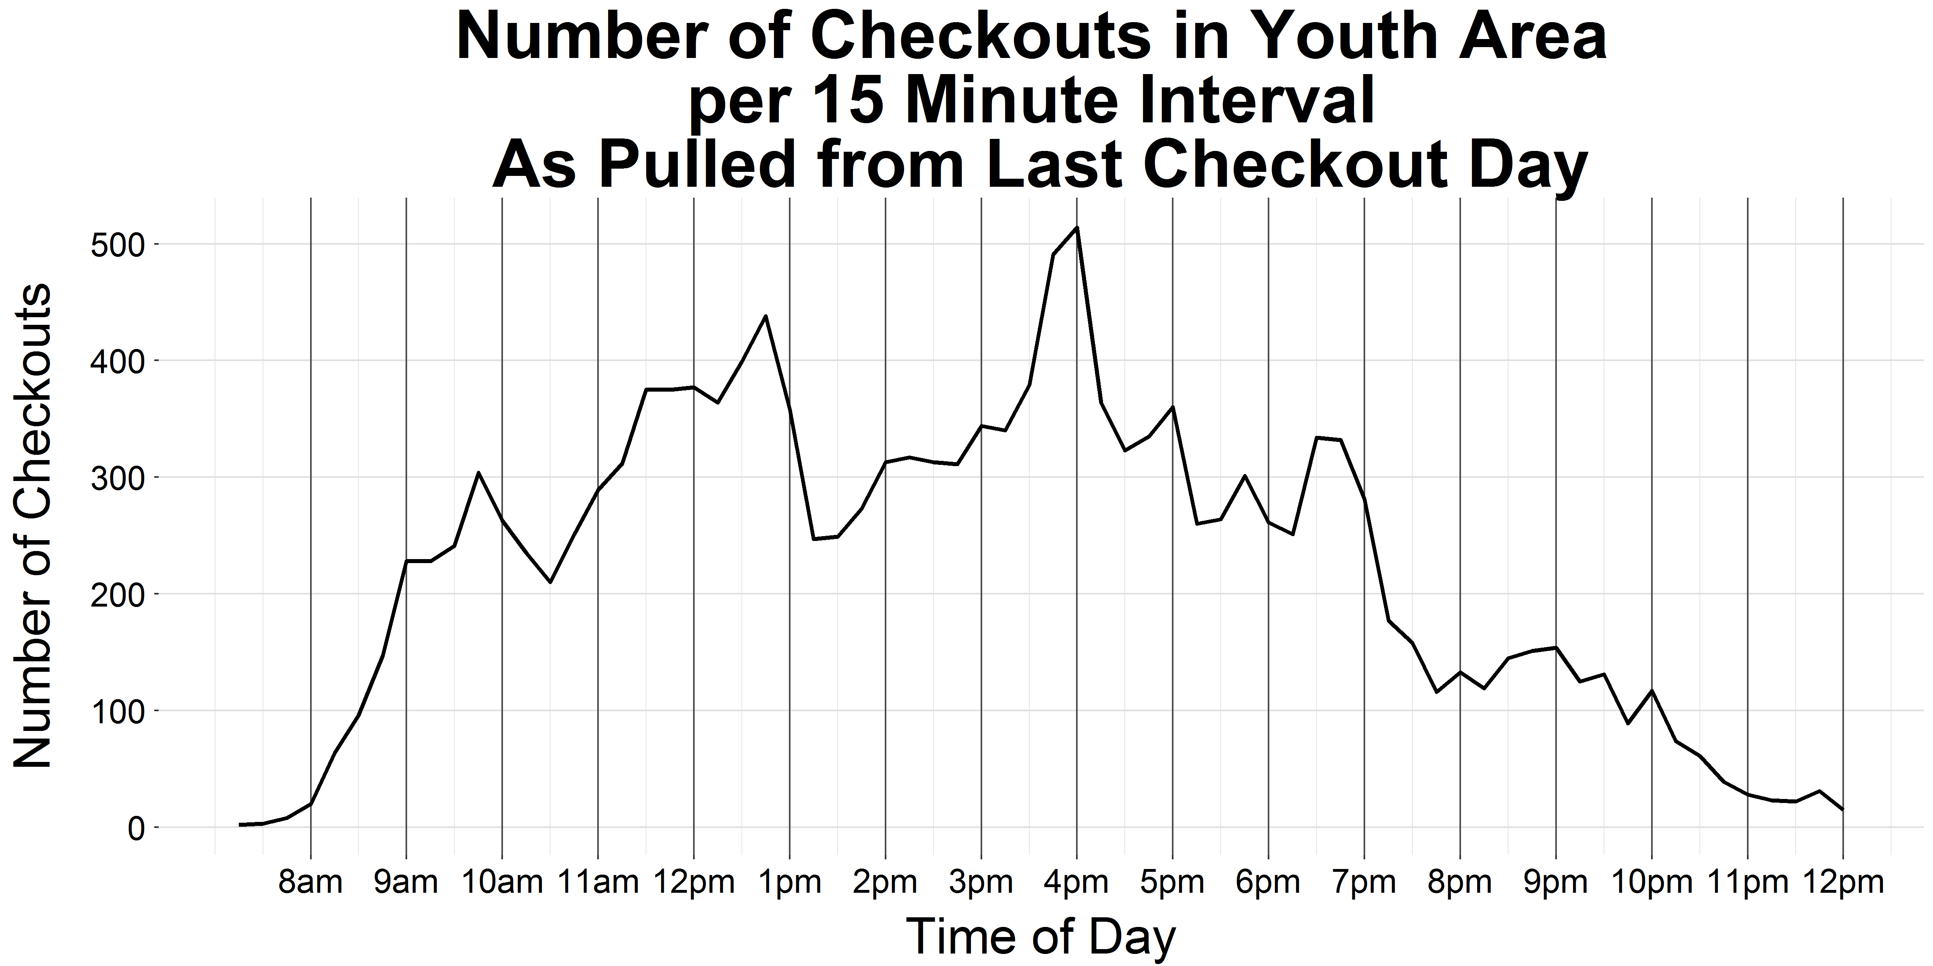
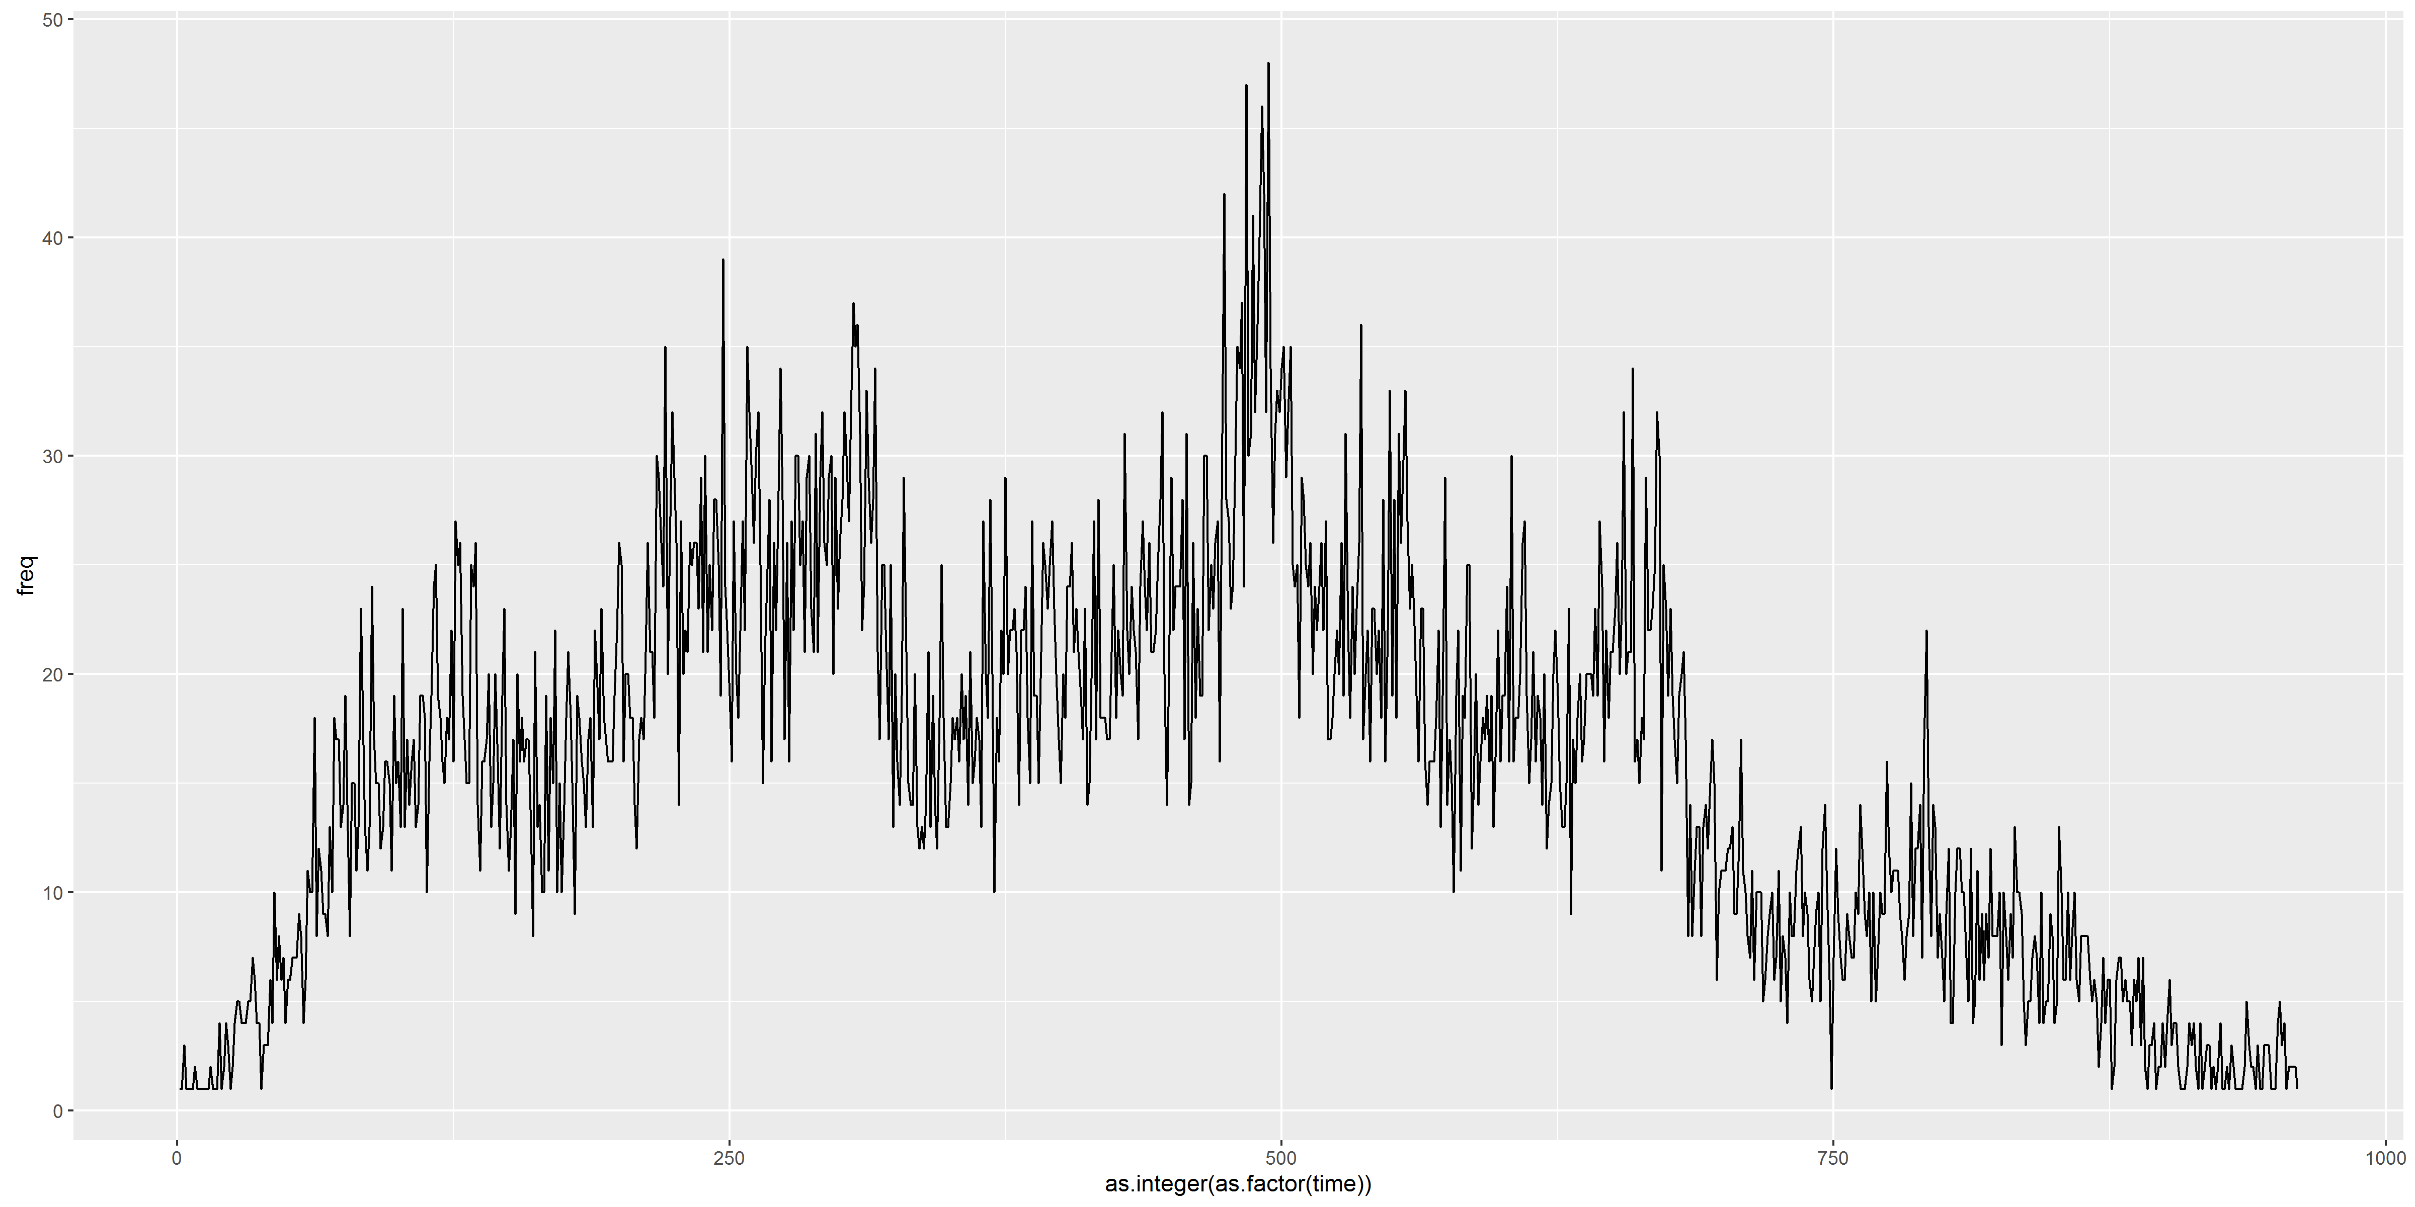
R uses in libraries
Manipulating dates/times

Slide 19
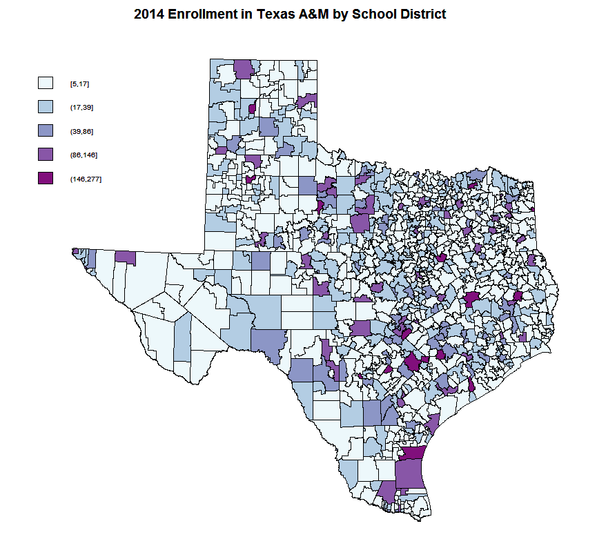

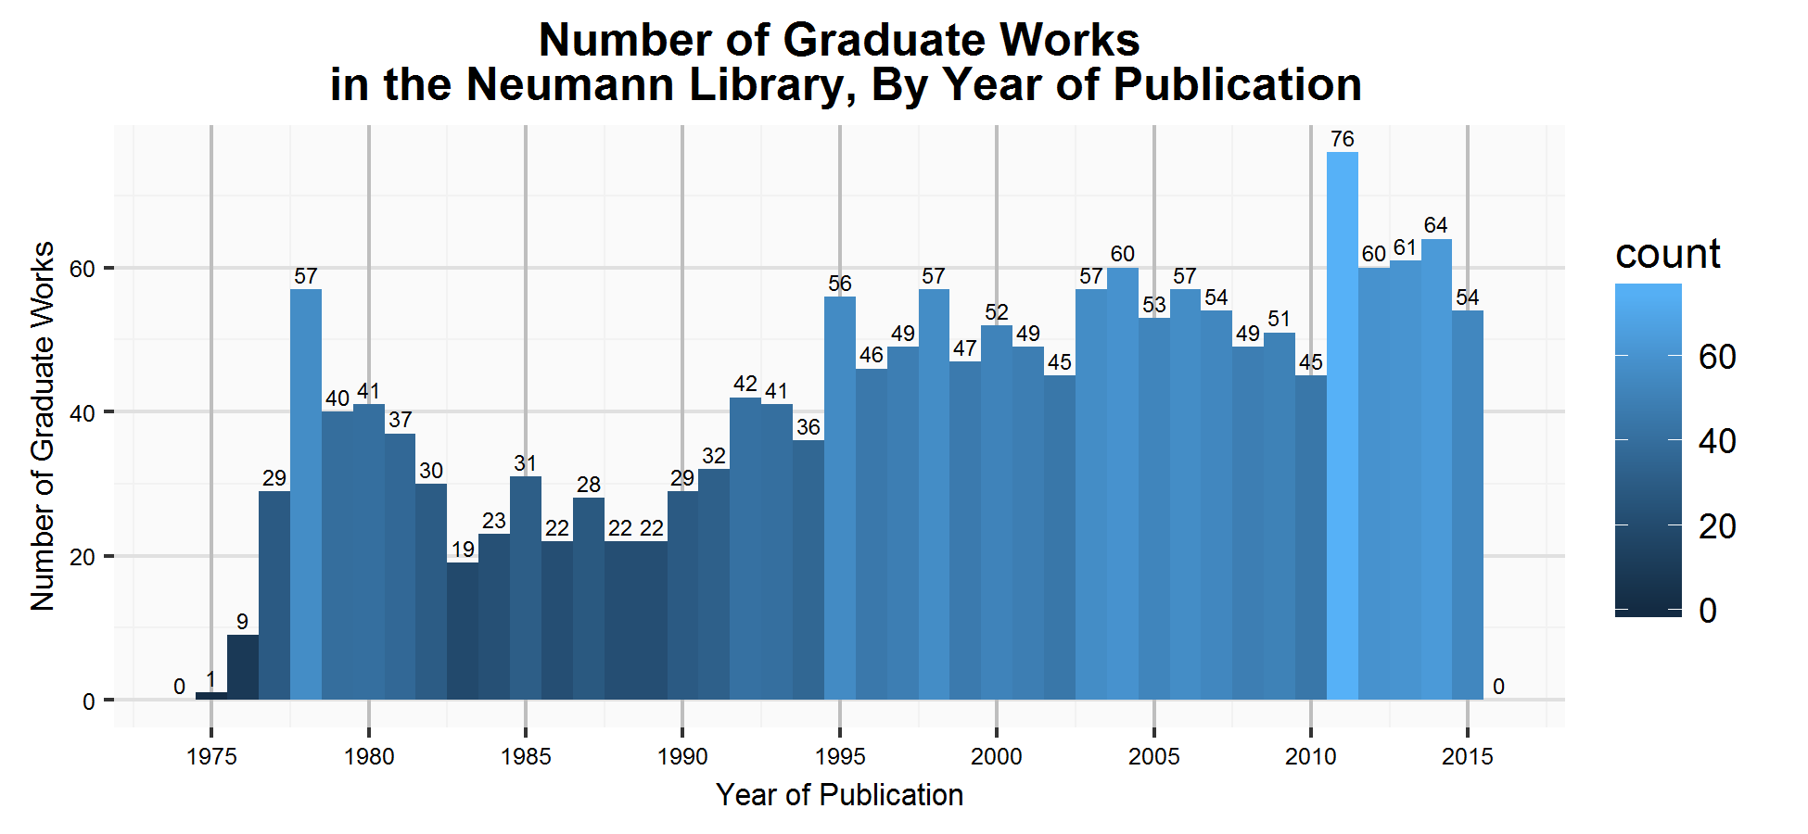
R uses in libraries
Creating visualizations

Slide 20



R uses in libraries
Querying APIs

Slide 21
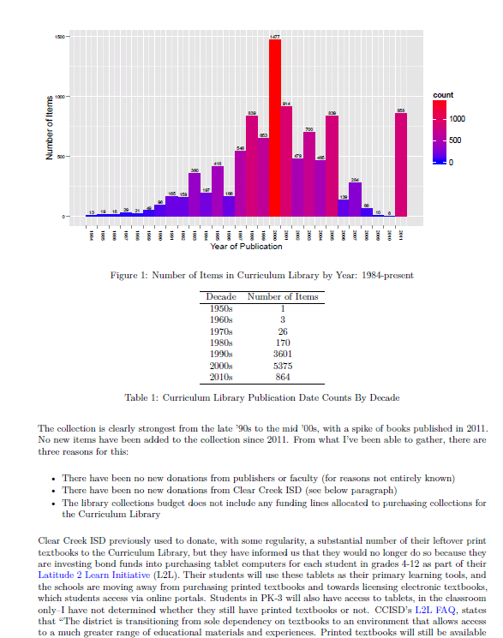
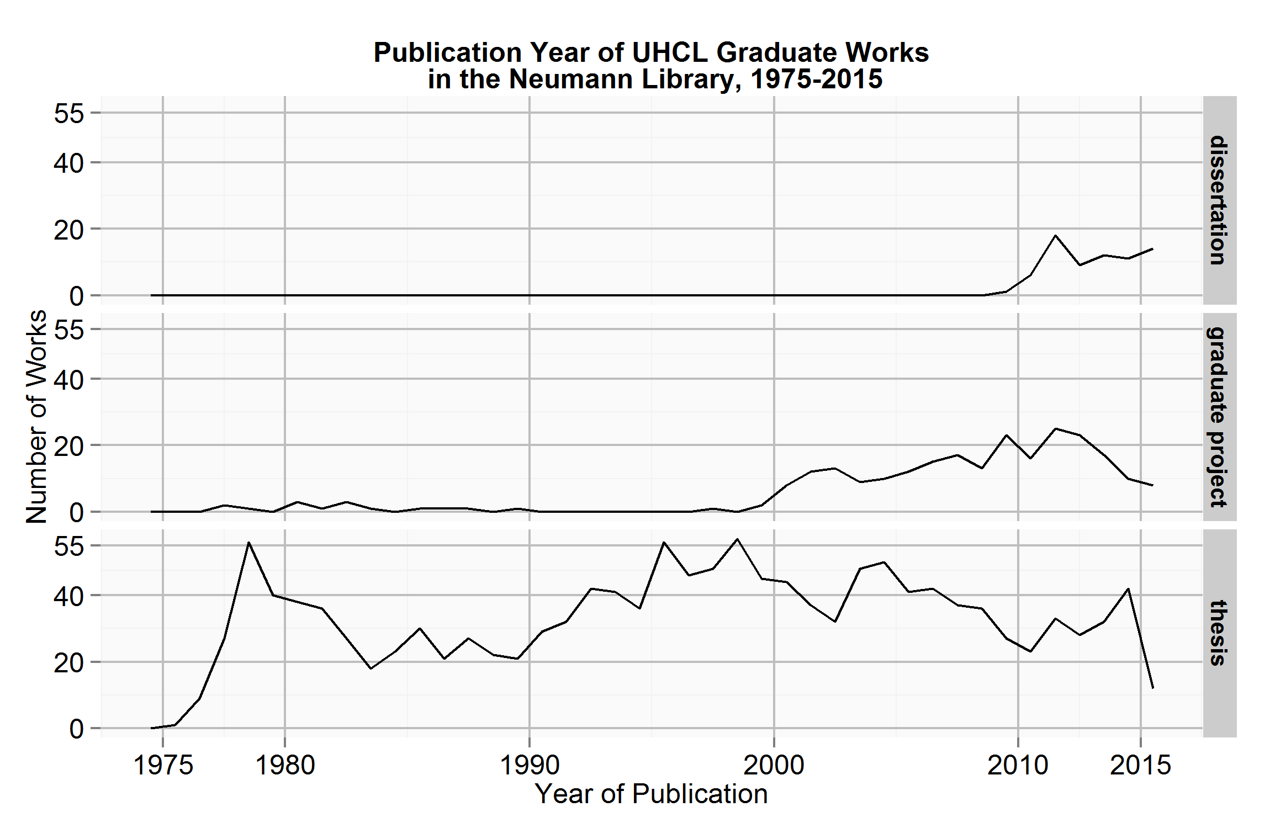
R uses in libraries
Analyzing collections
Data reference
Website/institutional repository analytics
Library usage statistics
Writing documents

Slide 22

R Studio
A user interface for working with R
You can use R without R Studio, but it's much more limiting
R Studio makes it easier to
Import data, write and save scripts, install packages, work with objects
Also free and open source
Download from rstudio.com

Slide 23
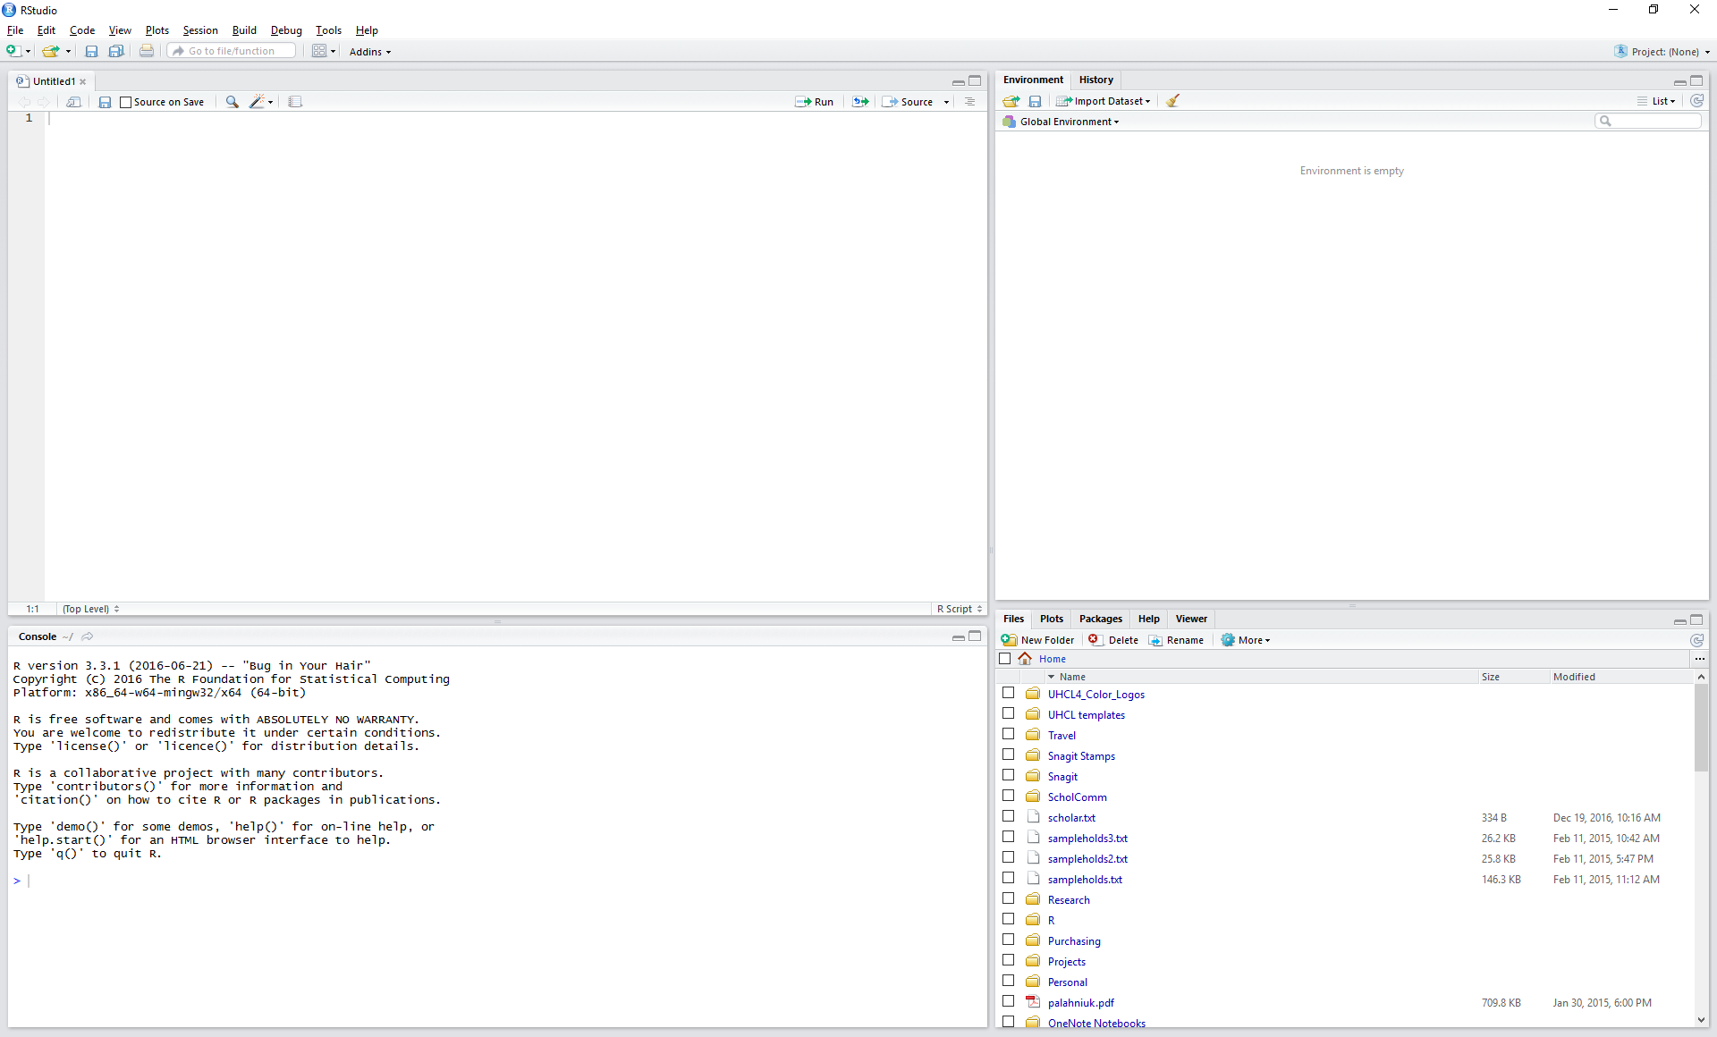
Panes in R Studio
Text Editor or Script Pane
Environment & History Pane
Console Pane
Navigation pane

Slide 24
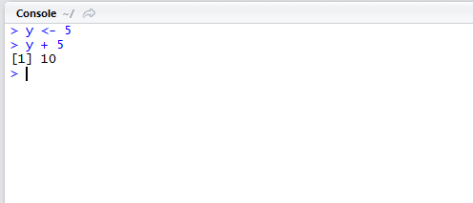
Panes in R Studio
Console Pane – bottom left
Type commands after the > prompt

Slide 25
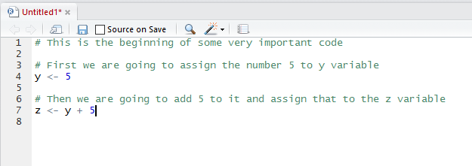
Panes in R Studio
Script Pane – upper left
Draft, run, and save scripts

Slide 26
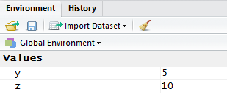
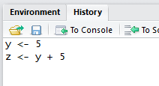
Panes in R Studio
Environment & History Pane – upper right
Shows objects read into R
Shows commands executed in the console

Slide 27
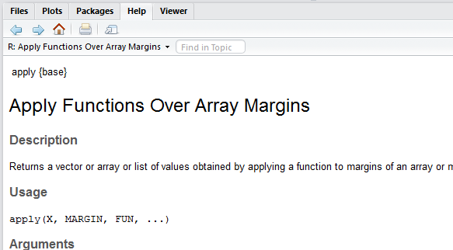
Panes in R Studio
Navigation pane – bottom right
Navigate to your files
View plots
Load Packages
See help files

Slide 28
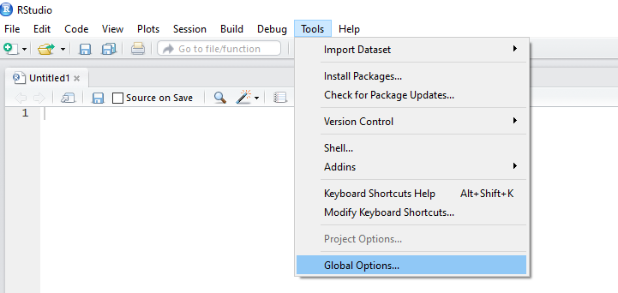
Panes in R Studio
Change pane size, layout, and appearance:
Go to Tools > Global Options

Slide 29
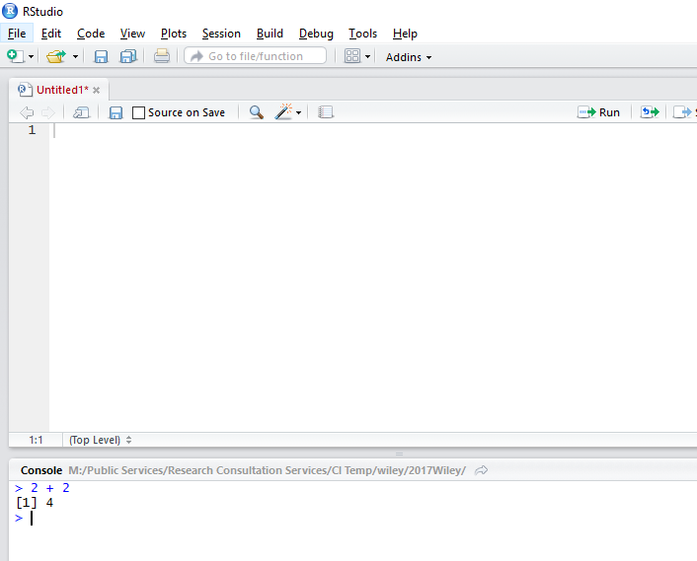
Writing expressions
The prompt is the blinking cursor in the console pane
We type expressions into the prompt, and press the Enter key to evaluate them
> 2 + 2
[1] 4
Command Prompt

Slide 30
Assigning values
<-
(Shift + comma and hyphen)
Assignment Operator (meant to look like an arrow )
Assign the number 5 to the symbol y using the assignment operator
We say, "y gets 5."
> y <- 5

Slide 31
Tips for assigning values
Pick almost any name for your symbols…
ebook_usage <- read.csv("Fall ebook usage.csv"
, header = TRUE)
…except names of functions that already exist in R (e.g. avoid "sum" or "data")
> sum(sum)

Slide 32
Tips for assigning values
R is case sensitive: a capital Y is not found
> y <- 5
> Y
Error: object 'Y' not found
Do not begin with numbers or symbols
> 1z <- 4
Error: unexpected symbol in "1z"
> %z <- 4
Error: unexpected input in "%z <- 4"

Slide 33
Tips for assigning values
No blank spaces or symbols other than underscore
> my data <- 1:10
Error: unexpected symbol in "my data"
> myData <- 1:10
> my_data <- 1:10
Be descriptive, but make your names short
> this_variable_name_is_too_long <- 1:10

Slide 34
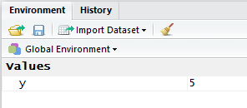
Evaluating expressions
Press enter in the console to evaluate the expression and return the result
> y <- 5
> y
[1] 5
The [1] means that the number 5 is the first element of this vector.

Slide 35
Evaluating expressions
You can assign anything to any variable, and then perform operations on or with that variable
> y <- 5
> z <- c(5, 10, 15)
> y + 20
[1] 25
> y + z
[1] 10 15 20
> y^2
[1] 25
> sum(y, z)
[1] 35

Slide 36
Calling a function
R contains a number of functions you use to do something with your data
Call a function on a variable by entering the function into the console followed by parentheses and the variables
Functions can be nested
> sum(3, 4)
[1] 7
> sum(sqrt(9), 4)
[1] 7
> is.function(sum)
[1] TRUE

Slide 37
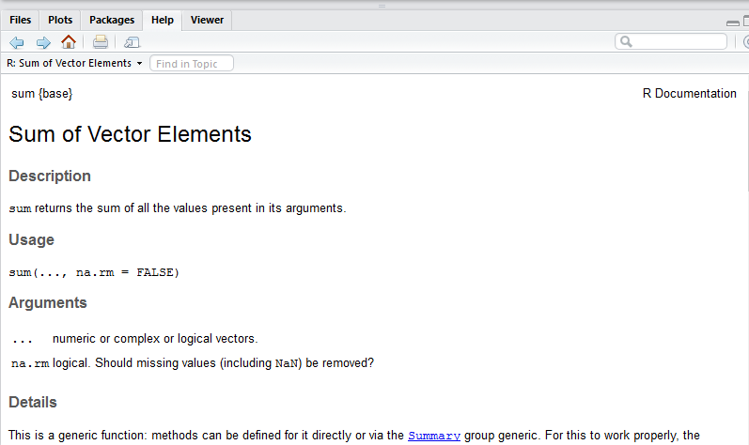
Calling a function
Get help by typing a question mark followed by the function, and viewing the Navigation pane
> ?sum
> help(sum)

Slide 38
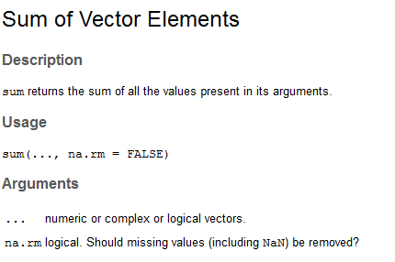
Calling a function
A function can take a specified number of arguments
> sum(3, 4, 5, 6, 7)
[1] 25
> sum(3, 4, NA)
[1] NA
> sum(3, 4, NA, na.rm = TRUE)
[1] 7

Slide 39
The str() function
str(): Compactly display information about an object
> dogBreeds <- c("beagle", "pug", "chihuahua")
> str(dogBreeds)
chr [1:3] "beagle" "pug" "chihuahua"

Slide 40
The c() function
c(): combine values into a vector
> x <- c(1, 2, 3, 4, 5)
> str(x)
num [1:5] 1 2 3 4 5

Slide 41
Objects & Vectors
Everything you manipulate in R is called an object.
Vectors are the most basic type of object
A vector is a sequence of elements of the same class

Slide 42
Types of vectors
numeric or integer
> my_integers <- 1:10
> str(my_integers)
int [1:10] 1 2 3 4 5 6 7 8 9 10
> class(my_integers)
[1] "integer"

Slide 43
Types of vectors
character
> my_characters <- c("Macbeth", "Dracula", "1984")
> str(my_characters)
chr [1:3] "Macbeth" "Dracula" "1984"
> class(my_characters)
[1] “character"

Slide 44
Types of vectors
logical
You can also use T and F
> my_logical <- c(TRUE, FALSE, FALSE, TRUE)
> str(my_logical)
logi [1:4] TRUE FALSE FALSE TRUE
> is.logical(my_logical)
[1] TRUE

Slide 45
Types of vectors
factors: represent categorical data
unordered (nominal) or ordered (ordinal)
Mostly useful for modeling functions in statistical analysis
I usually coerce my factors to character strings when I read in data
stringsAsFactors = F

Slide 46
Types of vectors
factors: represent categorical data
unordered (nominal) or ordered (ordinal)
> my_nominal_factor <- factor(c("book","dissertation", "journal", "book", "dissertation"))
> table(my_nominal_factor)
my_nominal_factor
book dissertation journal
2 1 2

Slide 47
Types of vectors
factors: represent categorical data
ordered (ordinal)
> my_ordinal_factor <- c("small", "medium", "large", "small", "large")
> my_ordinal_factor <- ordered(my_ordinal_factor
, levels = c("small", "medium", "large"))
> my_ordinal_factor
[1] small medium large small large
Levels: small < medium < large
> levels(my_ordinal_factor)
[1] "small" "medium" "large"

Slide 48
Subsetting a vector with brackets
> scale <- c("do", "re", "mi", "fa", "so")
> scale[1]
[1] "do"
> scale[5]
[1] "so"
> scale[c(1, 5)]
> [1] "do" "so"
> scale[c(T, F, F, F, T)]
> [1] "do" "so"

Slide 49
Lists
A vector can only contain objects of the same class…
…except for lists, which can contain multiple objects of different classes
> my_list <- list(1:10
, c("beagle", "pug", "chihuahua")
, TRUE)
> str(my_list)
List of 3
$ : int [1:10] 1 2 3 4 5 6 7 8 9 10
$ : chr [1:3] "beagle" "pug" "chihuahua"
$ : logi TRUE

Slide 50
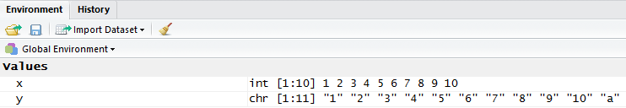
Types of vectors
If you mix different objects in one vector, R will coerce the vector to be a single class
> y <- c(1:10, "a")
> str(y)
chr [1:11] "1" "2" "3" "4" "5" "6" "7" "8" "9" "10" "a“
> "1" + "2"
Error in "1" + "2" : non-numeric argument to binary operator

Slide 51
NA
A way to deal with missing values
Use is.na() to test if a value is NA or not
Conversely, use complete.cases() to test if a value is not missing
> vec <- c("value1", "value2", NA)
> is.na(vec)
[1] FALSE FALSE TRUE
> vec[is.na(vec)]
[1] NA
> vec[complete.cases(vec)]
[1] "value1" "value2"

Slide 52
Getting data into R
Manually create it
Import it from a file
Text file: TXT, CSV, TSV
Excel: XLSX
Statistics program: SPSS, MATLAB, Stata
Databases: MySQL
JSON, HTML, XML
Gather it from the web
Connect to webpages, servers, or APIs
Webscraping

Slide 53
Data frames
A grid of rows and columns
Each column
is a vector of the same length
is a single data type
The tidyverse includes a more efficient version of a data frame, called a tibble

Slide 54
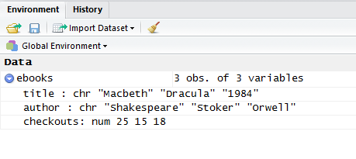
Data frames
> ebooks <- tibble("title" = c("Macbeth","Dracula","1984")
, "author" = c("Shakespeare","Stoker","Orwell")
, "checkouts" = c(25, 15, 18))

Slide 55
Data frames
You can print small data frames to the console…
> print(ebooks)
title author checkouts
1 Macbeth Shakespeare 25
2 Dracula Stoker 15
3 1984 Orwell 18

Slide 56
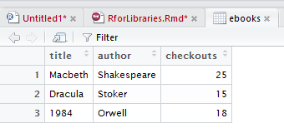
Data frames
But for larger data frames it’s better to call the View() function
> View(ebooks)
Or to click on the object in the Environment pane.

Slide 57

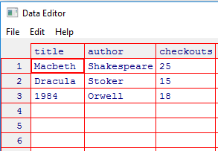
Data frames
Can you edit data by hand as with spreadsheets?
Yes…But it’s best practice to script and document all modifications
> edit(ebooks)

Slide 58
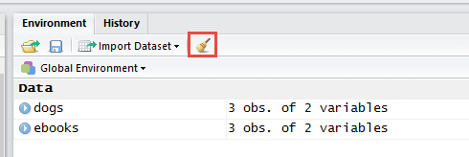
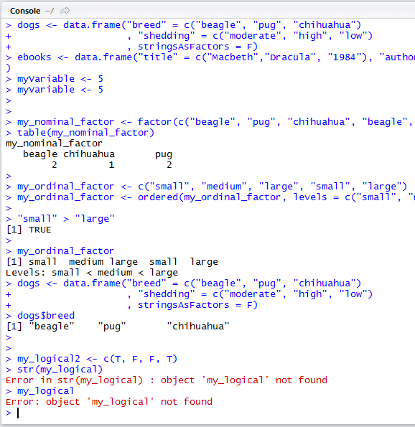
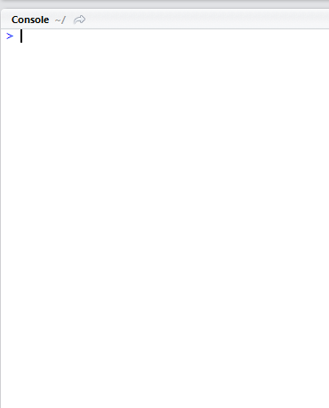
Working in R Studio
Clear all objects from the workspace: click the broom in the Environment/History (upper right) pane,
Clear specific objects from the workspace
> rm(dogs)
Clear console: Press Ctrl + L (Command + L on Mac)
or go to Edit > Clear Console

Slide 59
Working in R Studio
While in the console (lower left pane), Press the up and down arrow keys on your keyboard to cycle through previously entered commands

Slide 60
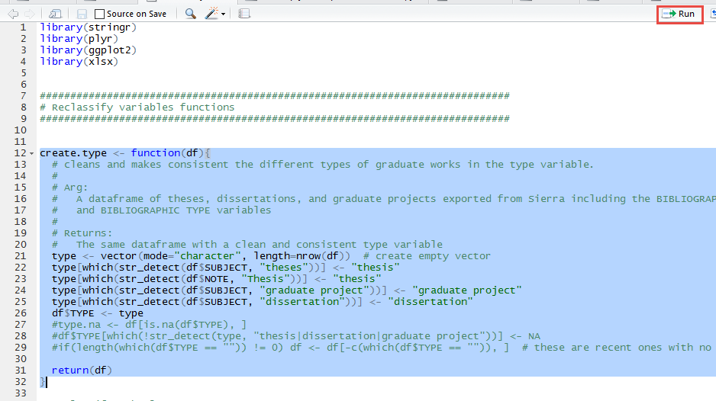
Working in R Studio
To execute code from the script pane, highlight chunks of code and either
Click the Run button
Press Ctrl + R

Slide 61
Troubleshooting errors
> str(Y)
Error: object 'Y' not found
You tried to run analysis on an object that has not been loaded into the environment. In other words, R can’t find what you’re looking for.
Check for typos, capitalization, spelling, etc.
Make sure the object has actually been loaded into R.

Slide 62
Troubleshooting errors
> average(c(0, 5, 10))
Error: could not find function "average"
> mean(c(0, 5, 10))
[1] 5
You tried use a function that doesn’t exist.
Check for typos, capitalization, spelling, etc.
Use is.function() to make sure it is actually a function.
If the function is from a package that has not yet been loaded, load the package using library()

Slide 63
Troubleshooting errors
> sum(3, 4
+
Hanging plus sign & blinking cursor: R is expecting something
In this case, it’s waiting for me to close my parentheses. Could be waiting for closed quotes as well.
Press the Escape key to interrupt the command, and add the required symbols.

Slide 64
Troubleshooting errors
> sum(4,;3)
Error: unexpected ';' in "sum(4,;"
You’ve entered a symbol in the wrong place.
R stops evaluating the expression when it runs into the unexpected symbol—check there.

Slide 65

You made it!
Refer to the handouts for exercises and more in-depth explanations.

